Slide 1
Stack and Queue

Slide 2

What is a Stack
Stack of Books

Slide 3
Stacks
What is a Stack?
  A stack is a data structure of ordered items such that items can be inserted and removed only at one end.

Slide 4
Stacks
What can we do with a stack?
  push - place an item on the stack
  peek - Look at the item on top of the stack, but do not remove it
  pop - Look at the item on top of the stack and remove it

Slide 5
Stacks
A stack is a LIFO (Last-In/First-Out) data structure
A stack is sometimes also called a pushdown store.
What are some applications of stacks?
  Program execution
  Parsing
  Evaluating postfix expressions

Slide 6
Stacks
Problem:
  What happens if we try to pop an item off the stack when the stack is empty?
    This is called a stack underflow. The pop method needs some way of telling us that this has happened. In java we use the java.util.EmptyStackException

Slide 7
Interface IStack
Interface Istack {
boolean empty();
void push(char c);
char pop();
char peek();
}

Slide 8
Using a IStack
A balance of braces.
  (()) balanced braces
  ()(()()))) not balanced braces
How can you use Istack to check a brace is balanced or not?
When you implement the above requirement, you ignore the implementation details of Istack.

Slide 9
Implementing a Stack
There are two ways we can implement a stack:
  Using an array
  Using a linked list

Slide 10
Implementing a Stack
Implementing a stack using an array is fairly easy.
  The bottom of the stack is at data[0]
  The top of the stack is at data[numItems-1]
  push onto the stack at data[numItems]
  pop off of the stack at data[numItems-1]

Slide 11
Implementing a Stack
Implementing a stack using a linked list isn’t that bad either…
  Store the items in the stack in a linked list
  The top of the stack is the head node, the bottom of the stack is the end of the list
  push by adding to the front of the list
  pop by removing from the front of the list

Slide 12
Reversing a Word
We can use a stack to reverse the letters in a word.
How?

Slide 13
Reversing a Word
Read each letter in the word and push it onto the stack
When you reach the end of the word, pop the letters off the stack and print them out.

Slide 14
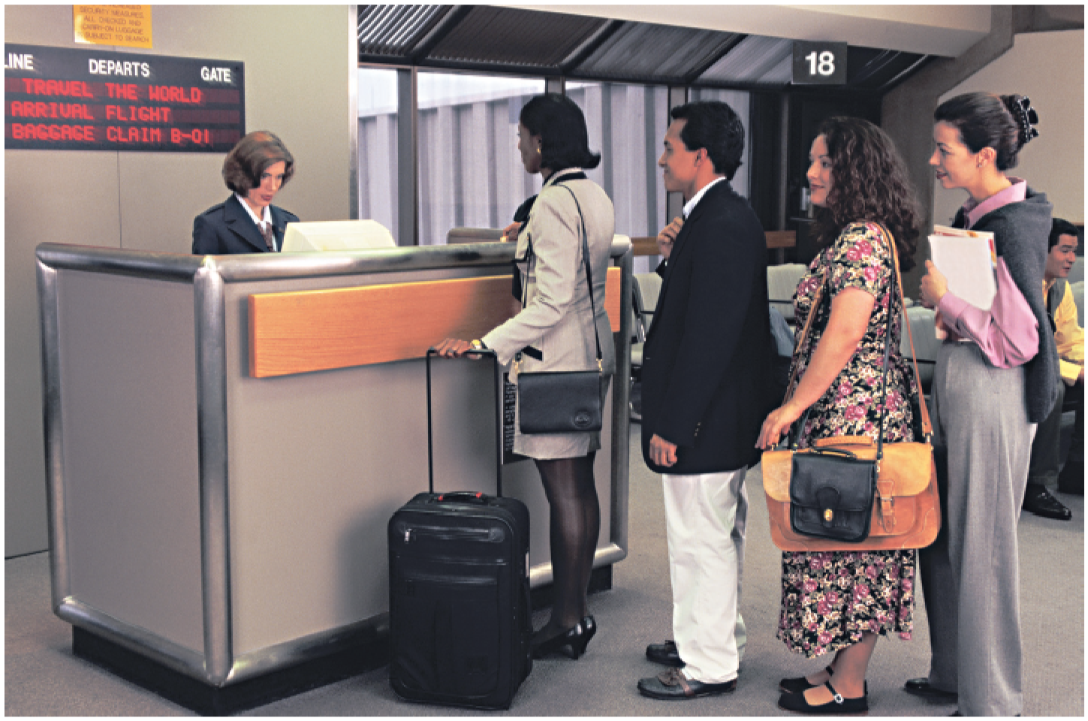
What is a Queue?

Slide 15
Queues
What is a queue?
  A data structure of ordered items such that items can be inserted only at one end and removed at the other end.
Example
  A line at the supermarket

Slide 16
Queues
What can we do with a queue?
  Enqueue - Add an item to the queue
  Dequeue - Remove an item from the queue
These ops are also called insert and getFront in order to simplify things.

Slide 17
Queues
A queue is called a FIFO (First in-First out) data structure.
What are some applications of queues?
  Round-robin scheduling in processors
  Input/Output processing
  Queueing of packets for delivery in networks

Slide 18
Implementing a Queue
Just like a stack, we can implementing a queue in two ways:
  Using an array
  Using a linked list

Slide 19
Implementing a Queue
Using an array to implement a queue is significantly harder than using an array to implement a stack. Why?
  Unlike a stack, where we add and remove at the same end, in a queue we add to one end and remove from the other.

Slide 20
Implementing a Queue
There are two options for implementing a queue using an array:
Option 1:
  Enqueue at data[0] and shift all of the rest of the items in the array down to make room.
  Dequeue from data[numItems-1]

Slide 21
Implementing a Queue
Option 2
  Enqueue at data[rear+1]
  Dequeue at data[front]
  The rear variable always contains the index of the last item in the queue.
  The front variable always contains the index of the first item in the queue.
  When we reach the end of the array, wrap around to the front again.

Slide 22
Implementing a Queue
// option 2 sketch of insert
  insert(Object item) {
  if(manyItems == 0) front = rear = 0;
  else rear = (rear + 1) mod size;
  data[rear] = item;
  manyItems++;
  }

Slide 23
Implementing a Queue
// option 2 sketch of getFront
  Object getFront() {
  answer = data[front];
  front = (front + 1) mod size;
  manyItems--;
  return answer
  }

Slide 24
Implementing a Queue
Implementing a queue using a linked list is still easy:
  Front of the queue is stored as the head node of the linked list, rear of the queue is stored as the tail node.
  Enqueue by adding to the end of the list
  Dequeue by removing from the front of the list.

